Slide 1
Balenciaga

Slide 2
Table of contents
01
02
03
04
05
Introduction
Scandal
Why this
Brand image
Company value

Slide 3
Introduction
01

Slide 4
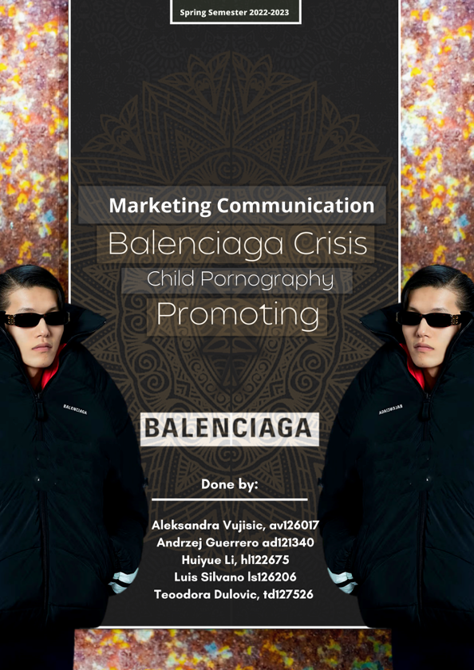
Balenciaga
Brand under Kering group
Founded by Spanish designer Cristóbal Balenciaga in 1919
Eexpanded beyond clothing and accessories to include footwear, fragrances, and even furniture collaborations

Slide 5
02
Scandal

Slide 6
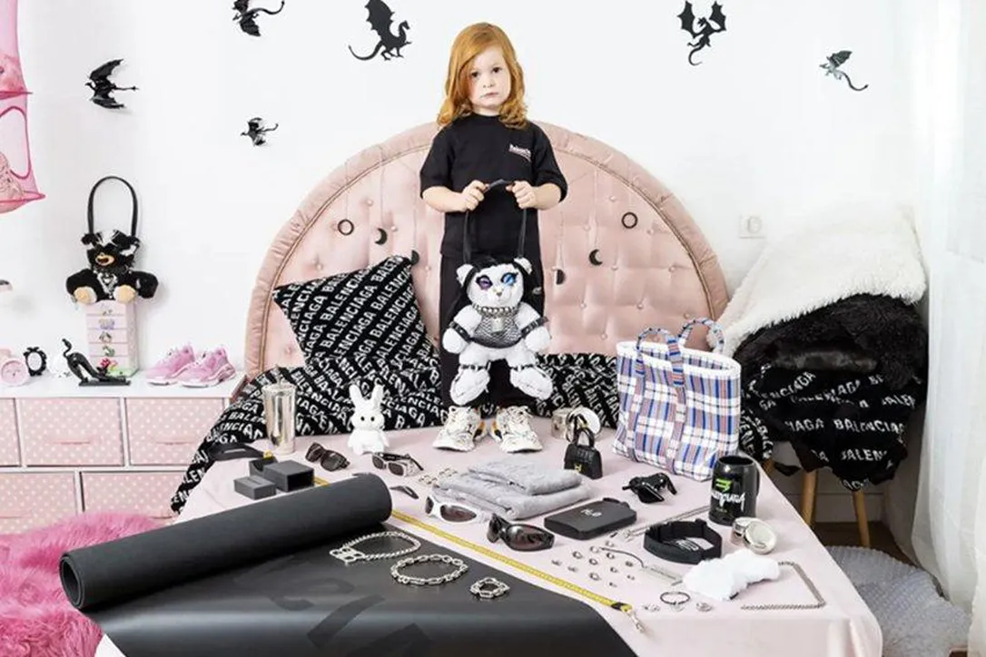
2022
Startle with an unusual theme, it crossed the limit of society
Showing images that can be related to pedophilia or relationships with minors

Slide 7
Why this
03

Slide 8

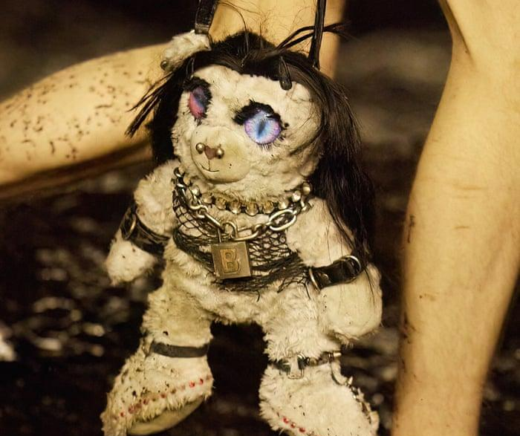
Balenciaga
Striking
Striking and harshly criticized by society
Huge impact among the public
Past vs Now
The history of crises the company endured, and we how it reacted to this new cancellation

Slide 9
04
Brand Image

Slide 10

Controversy
propaganda
Want to compete with other brands so keep using unusual “shockvertising”
Try not to be repetitive with the competition or with previous installments
“No” to child pornography
A campaign related to death is better viewed than "promoting pedophilia" since one can see it as a form of complaint or symbolism
Guerrilla Marketing

Slide 11
Company value
05

Slide 12
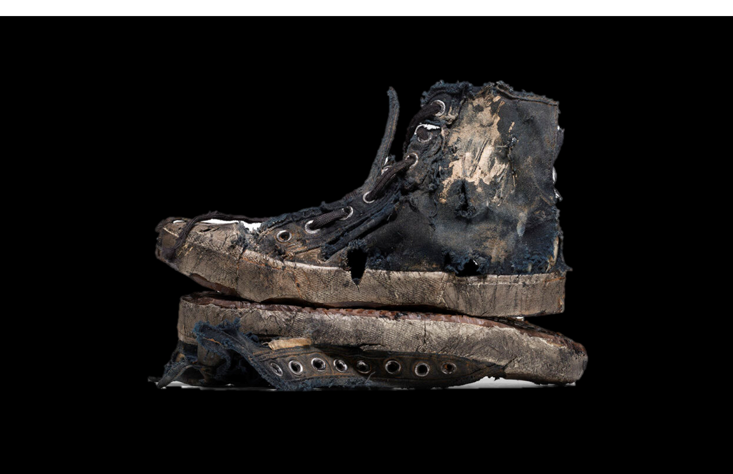
Company
value
target
Keep targeting different generations’ young people
Life cycle
Product life cycle is depending on clients’ life cycle
Brand’s style
Prohibited things: tobacco, bloods, cults and illegal things

Slide 13
conclusion

Slide 14

We learn from mistakes
Change
Positive
Change the style of the brand
Eliminate the negative effects

Slide 15
Change since now
Relation
attractive
Keep good relations with the public
Keep creative in a positive way

Slide 16


Thank you

